Slide 1
Association

Slide 2
Association
Association is a semantically weak relationship (a semantic dependency) between otherwise unrelated objects.
An object communicates to another object to use functionality and services provided by that object.
An association is a “using” relationship between two or more objects in which the objects have their own lifetime and there is no owner.

Slide 3
Example
As an example, imagine the relationship between a doctor and a patient. A doctor can be associated with multiple patients. At the same time, one patient can visit multiple doctors for treatment or consultation. Each of these objects has its own life cycle and there is no “owner” or parent. The objects that are part of the association relationship can be created and destroyed independently.

Slide 4
Association
In UML an association relationship is represented by a single line.
An association relationship can be represented as one-to-one, one-to-many, or many-to-many (also known as cardinality).
Essentially, an association relationship between two or more objects denotes a path of communication (also called a link) between them so that one object can send a message to another.

Slide 5
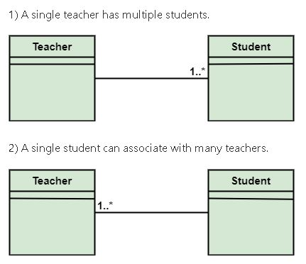
UML Representation

Slide 6
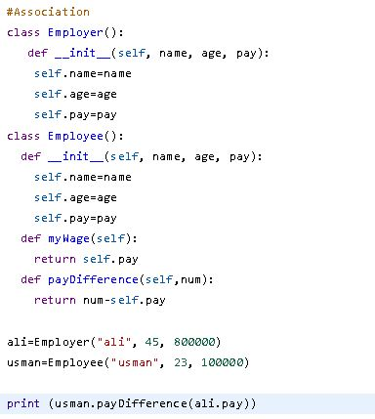
Association in Python

Slide 7
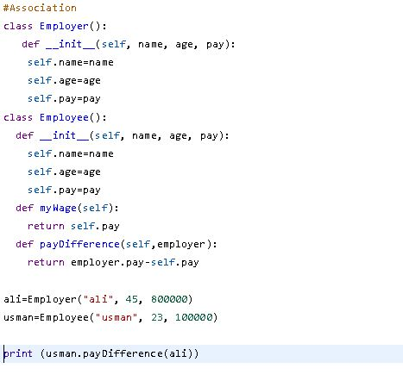
Association in Python

Slide 8
Class VARIABLES or STATIC VARIABLES

Slide 9
Class/Static Variables
Static means, that the member is on a class level rather on the instance level.
Static variables exist only on class level and aren't instantiated.

Slide 10
Class/Static Variables
All objects share class or static variables.
An instance or non-static variables are different for different objects (every object has a copy).
If you change a static variable in one instance of the class, the change will affect its value throughout the program so avoid it.

Slide 11
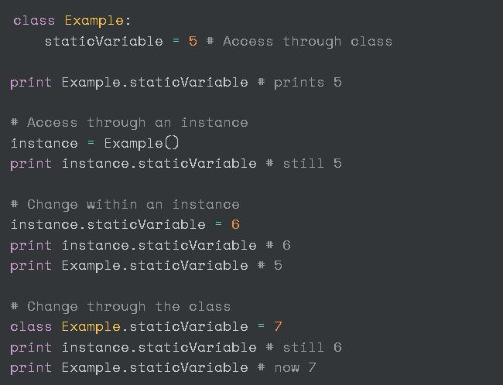
Example

Slide 12
Confusion?
The only confusion might arise from the fact that you can have two different variables in your class with the same name (one static and one ordinary). I wouldn't recommend relying on that behaviour in your code. So avoid accessing static variables with class instances.

Slide 13
Example
For example, let a Computer Science Student be represented by a class CSStudent. The class may have a static variable whose value is “cse” for all objects. And class may also have non-static members like name and roll.

Slide 14
Class/Static Variables
Static variables are defined inside the class definition, but outside of any method definitions.
They are typically initialized with a value, just like an instance variable, but they can be accessed and modified through the class itself, rather than through an instance.

Slide 15
Features of Static Variable
Static variables are allocated memory once when the object for the class is created for the first time.
Static variables are created outside of methods but inside a class
Static variables can be accessed through a class but not directly with an instance.
Static variables behavior doesn’t change for every object.

Slide 16
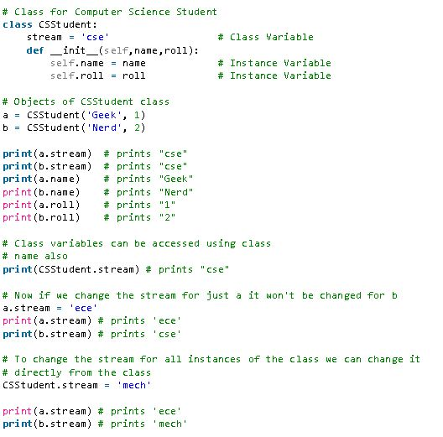
Example

Slide 17
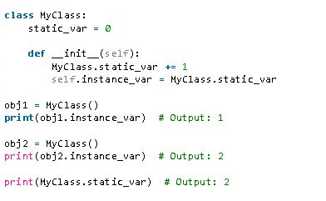
Counting Objects Scenario

Slide 18
Advantages
Memory efficiency: Since static variables are shared among all instances of a class, they can save memory by avoiding the need to create multiple copies of the same data.
Shared state: Static variables can provide a way to maintain shared state across all instances of a class, allowing all instances to access and modify the same data.
Easy to access: Static variables can be accessed using the class name itself, without needing an instance of the class. This can make it more convenient to access and modify the data stored in a static variable.
Initialization: Static variables can be initialized when the class is defined, making it easy to ensure that the variable has a valid starting value.
Readability: Static variables can improve the readability of the code, as they clearly indicate that the data stored in the variable is shared among all instances of the class.

Slide 19
Class Task
Show association between apartment in which maximum four students can live in.

